Slide 1
Bridging the Virtual Trio: Health, Work, and Life
Siva Abhishek Sirivella
TCS

Slide 2
This prototype will be starting at 9 AM in the morning and then it will first sleep for 30 mins for the first break for 5 minutes. In this break process this prototype will show a page and then block all the keys of keyboard and then disables the movement of mouse. Then after 5 minutes, the prototype will exit the screen and then unblocks all the keyboard and the mouse movements. Again the prototype goes to sleep for 30 minutes and then again it will show the break screen along will disabling the keyboard and mouse. By this process, the user will be forced to take a break instead of sitting for long time to complete the tasks assigned. From 12:30 to 1:30, The break screen shows LUNCH BREAK for 1hour for user to have their lunch at time so that user can maintain all the trio i.e., Health, Work and Life.
The next two pages shows the outputs for the screens.

Slide 3
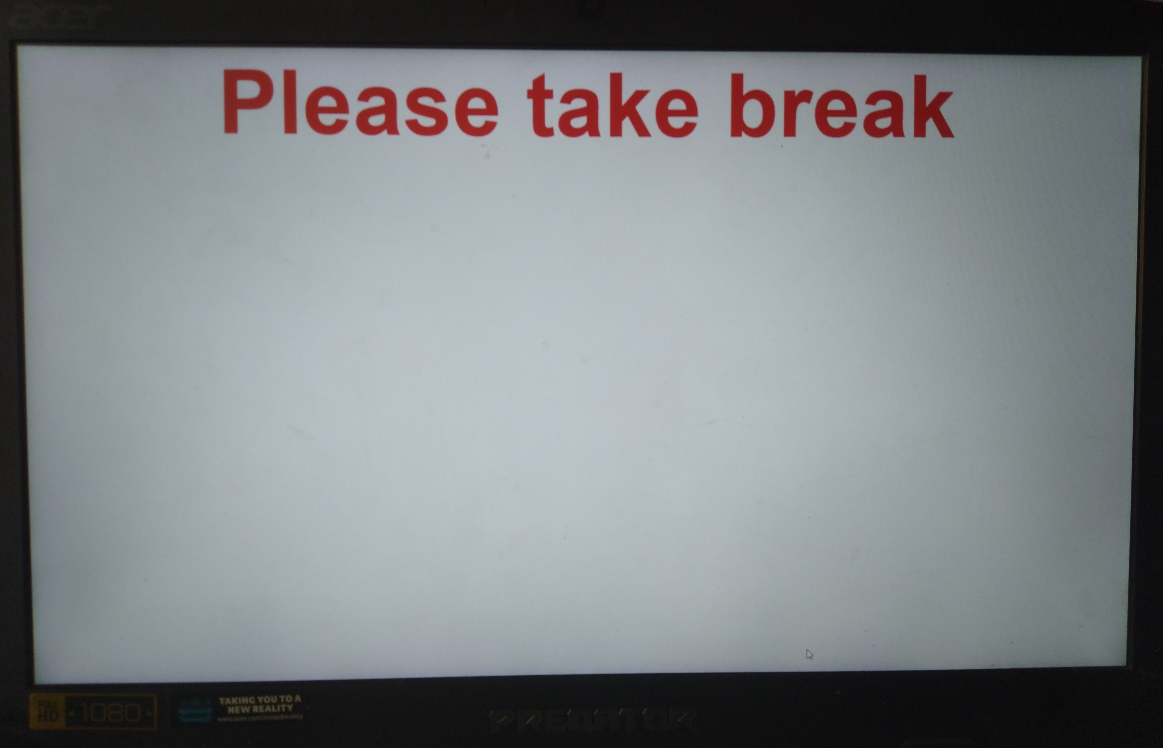

Slide 4
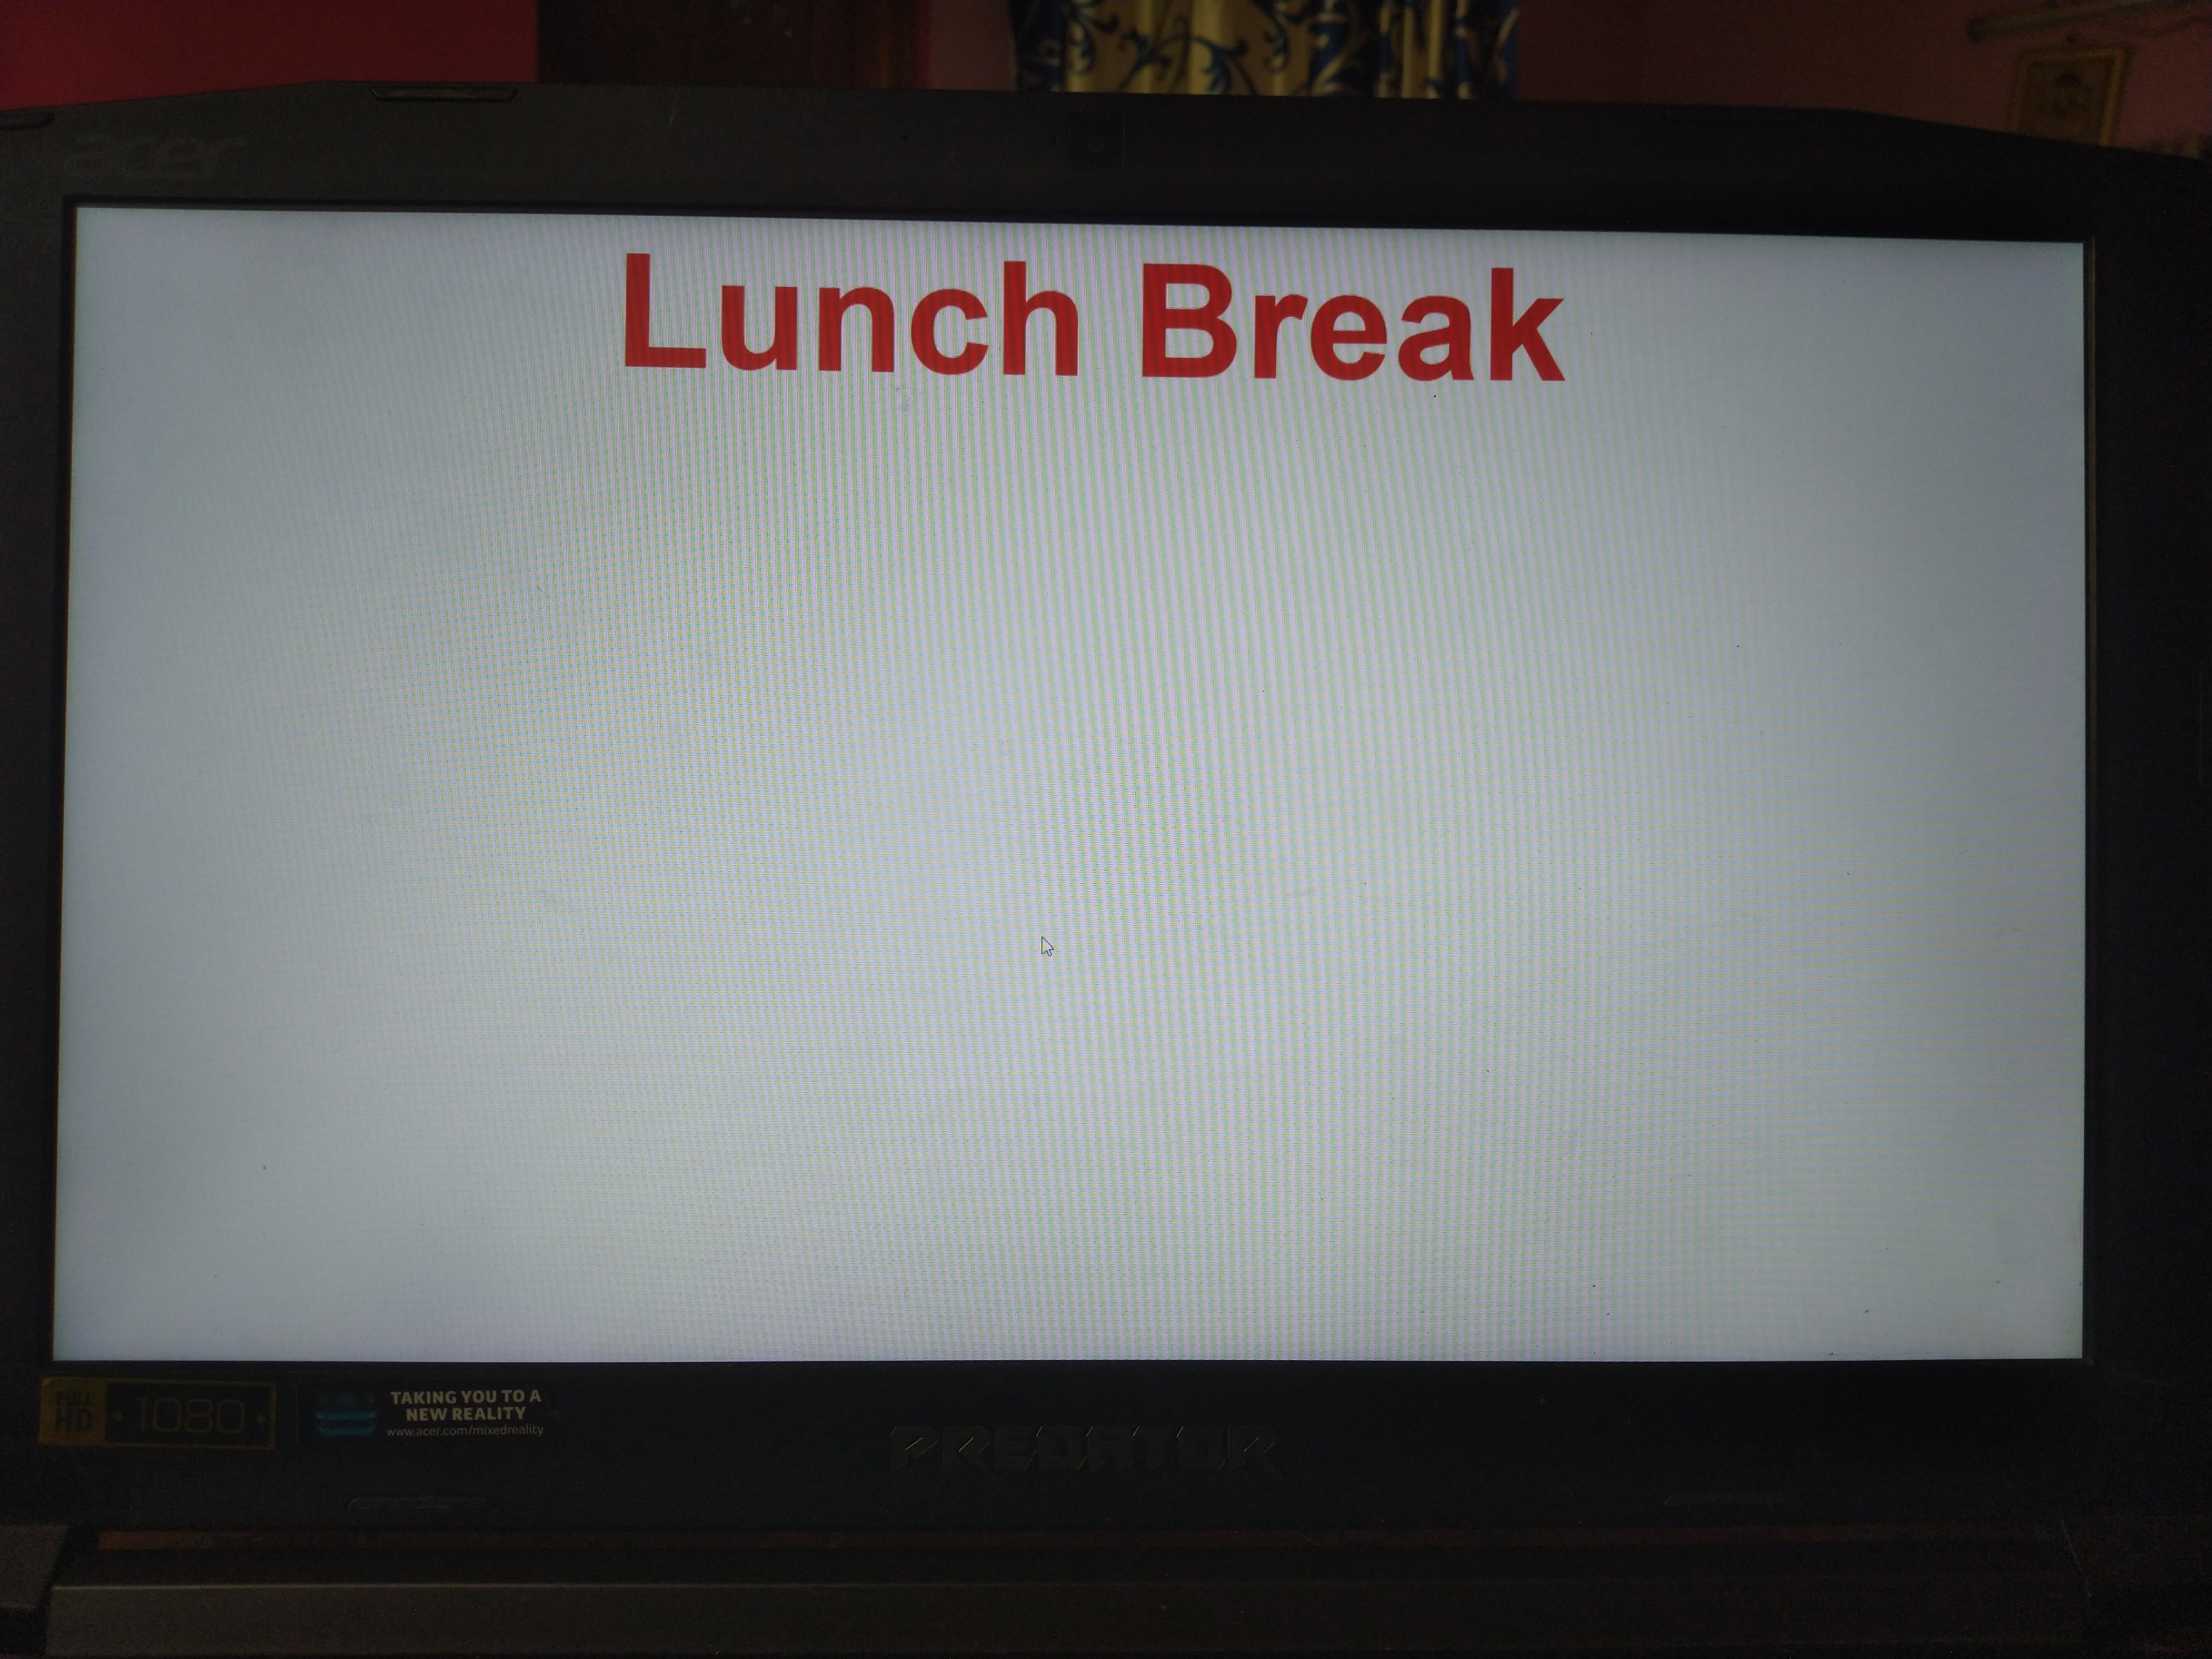

Slide 5
THANK YOU

